Slide 1
Protein Kinases

Slide 2
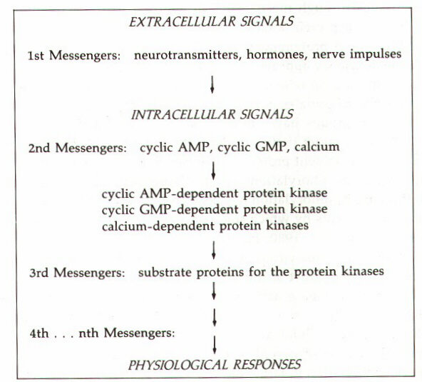
Second Messenger Hypothesis

Slide 3
Protein kinase
A protein kinase is a kinase enzyme that modifies other proteins by chemically adding phosphate groups to them (phosphorylation).
Phosphorylation usually results in a functional change of the target protein by changing enzyme activity, cellular location, or association with other proteins.
The human genome contains about 518 protein kinase genes and they constitute about 2% of all human genes.
Kinases are known to regulate the majority of cellular pathways, especially those involved in signal transduction.
Protein kinases are also found in bacteria and plants, where they take an active participation in mechanistic cellular signaling.

Slide 4
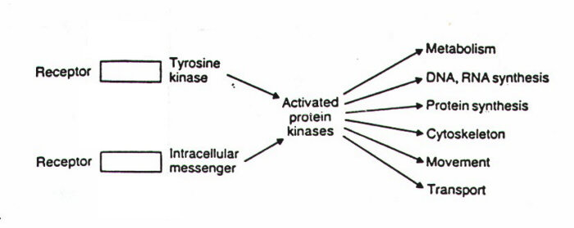
Protein Kinases in Animal Cells
Kinases
The first messenger
interacts with a receptor
and a second messenger is formed
Cell division
Apoptosis

Slide 5
History and Importance
About 518 genes in humans encode protein kinases;
Protein kinases are the fourth largest gene family in humans
  C₂H₂ zinc finger proteins (3%)
  G-protein coupled receptors (2.8%)
  Major histocompatibility (MHC) complex protein family (2.8%)

Slide 6
How Many Protein Kinases Are There?
The kinome refers to all protein kinases in the genome
There are 478 conventional eukaryotic protein kinases (ePKs) plus 106 pseudogenes
  388 Protein-serine/threonine kinases
  90 Protein-tyrosine kinases
    58 receptor PTKs
    32 Non-receptor PTKs
There are 40 atypical protein kinases (e.g. EF2K/alpha kinases)
478 + 40 = 518

Slide 7
Protein Kinase Classifications
Protein-Serine/threonine
Protein-Tyrosine
  Receptor: ligand binding domain and catalytic site on the same polypeptide
  Non-receptor: catalytic domain separate from the receptor
Dual Specificity (both serine/threonine and tyrosine) also occur
Broad Specificity: have several substrates, e.g., PKA
Narrow Specificity: have one or a few substrates, e.g., pyruvate dehydrogenase kinase with one substrate
Classified by activator: PKA, PKG, PKC
Notes:
Add RR page 60 for reaction type

Slide 8
General Classes I
ACG Group
Protein kinase A; cyclic AMP-dependent protein kinase
Protein kinase C
Protein kinase G
Basic amino acid-directed enzymes that phosphorylate serine/threonine.

Slide 9
General Classes II
CaMK
Calcium-calmodulin-dependent protein kinases
  I
  II
  III
  IV
Type II is a broad specificity kinase
The others are dedicated kinases with a limited substrate specificity

Slide 10
General Classes III
CMGC
Cyclin-dependent protein kinases
  These are important regulators of the cell cycle
MAP (Mitogen activated protein/microtubule associated protein) kinases
  Many of these promote cell division
GSK3 (glycogen synthase kinase-3)
Clk (Cyclin-dependent like kinase)

Slide 11
General Classes IV
PTK (Protein-tyrosine kinases)
  Receptor, e.g., epidermal growth factor receptor, insulin receptor
  Non-receptor, e.g., Src, Abl protein kinases
Specifically phosphorylate protein-tyrosine (note they are not tyrosine kinases but protein-tyrosine kinases)

Slide 12
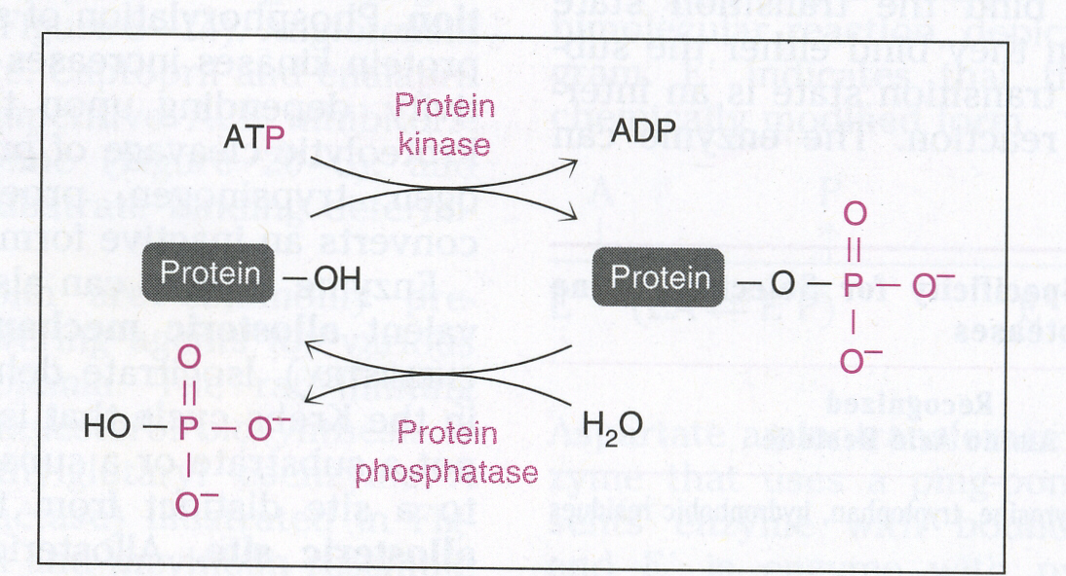
Protein Kinase and P’ase Rxns

Slide 13
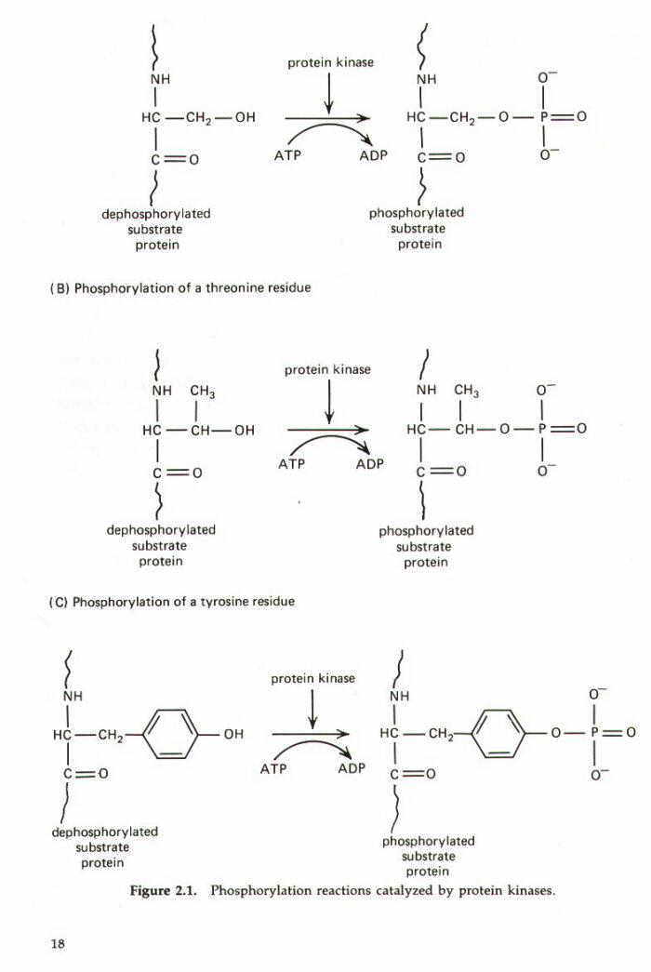
Reactions and Types of Protein Kinases
Be able to recognize the three amino acids with an –OH in their R-group
  Serine
  Threonine
  Tyrosine
Notes:
Need to add RR picture before this slide

Slide 14
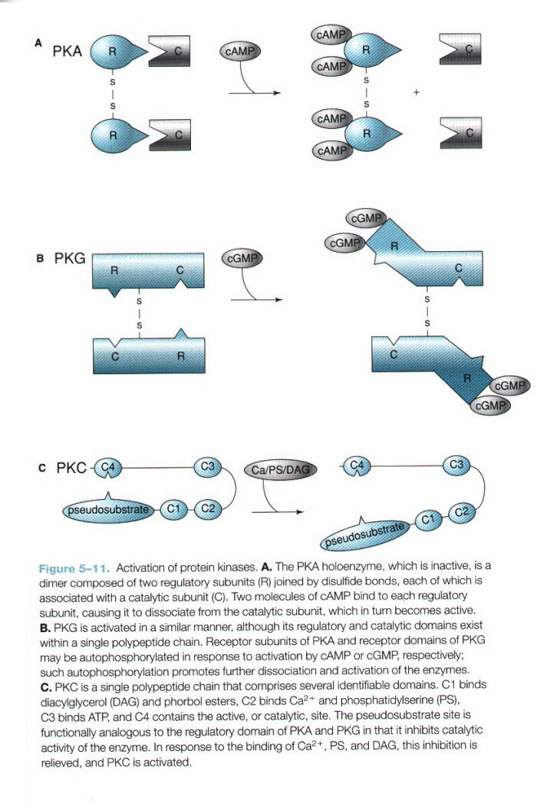
Activation of Protein Kinases
Known PKA activation mechanism
  It is the only one where there is a dissociation of regulatory subunits from catalytic subunits
  This was the first activation mechanism to be described, but it turns out to be atypical or unique
PKG, allosteric
PKC, allosteric

Slide 15
Protein Kinase A
Activated by cAMP
Regulation of glycogen, sugar and Lipid metabolism.
Secondary Messenger
The protein enzyme contains two catalytic subunits and two regulatory subunits.
When there is no cAMP, the complex is inactive.
When cAMP binds to the regulatory subunits, their conformation is altered, causing the dissociation of the regulatory subunits, which activates protein kinase A and allows further biological effects.

Slide 16
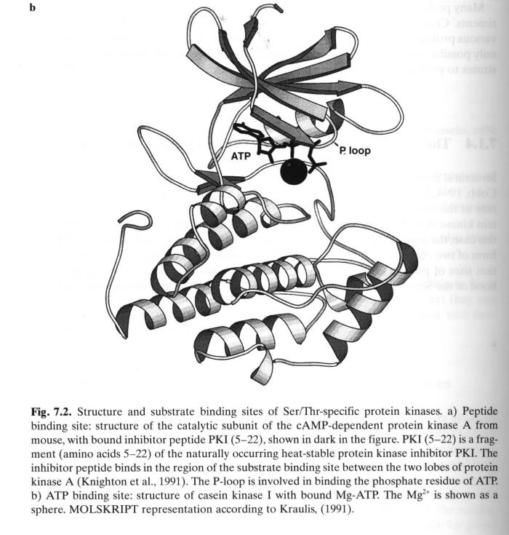
Protein Kinase A Structure
Bilobed
  N-lobe (upper) mostly beta sheet
  C-lobe (lower) mostly alpha helix
Active site between the two lobes
ATP is bound in the active site

Slide 17
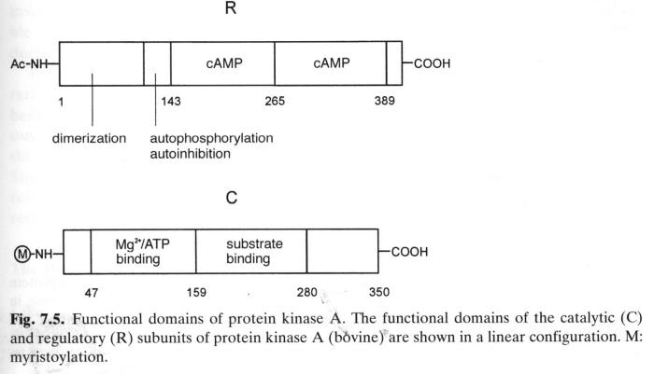
PKA Domain Structure

Slide 18
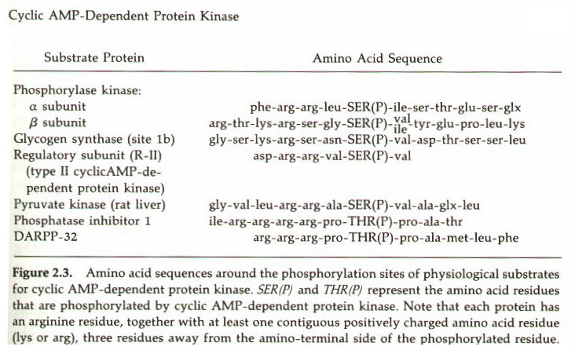
PKA Substrate Specificity
Basic-Basic-Xxx-Ser-Hydrophobic is preferred

Slide 19
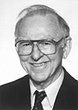
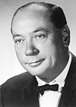
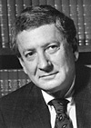
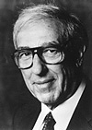
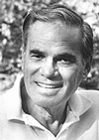
Earl W. Sutherland, Jr (cAMP)
Edwin Krebs (PKA) Albert G. Gilman (G-protein)
Edmund Fischer (PKA) Martin Rodbell( G-protein)

Slide 20
Protein Kinase G
Activated by cGMP
Second second messenger protein kinase (after cAMP)
Little known about physiological protein substrates despite needs extensive investigation
Two types of guanylyl cyclase
  Second messenger generated by atrial naturetic factor as an integral membrane guanylyl cyclase.
  Second messenger generated by NO action on the soluble guanylyl cyclase reaction.

Slide 21
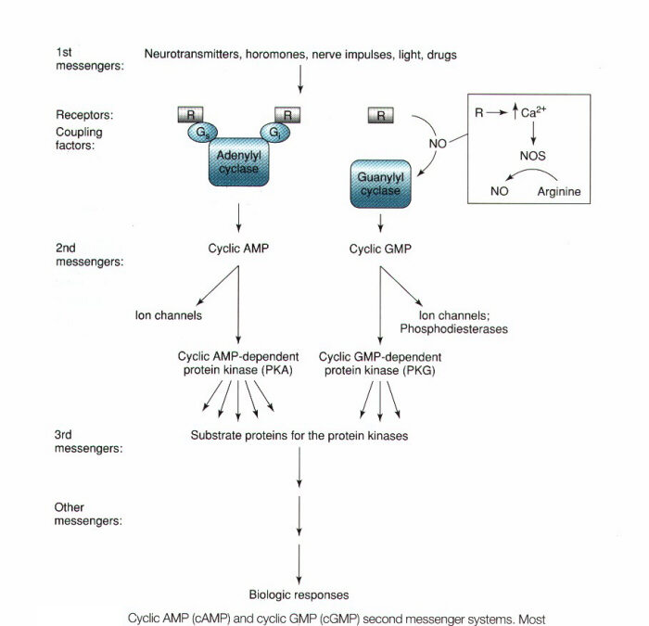
Action of cGMP
Review Fig 19-23 for
NO biosynthesis

Slide 22
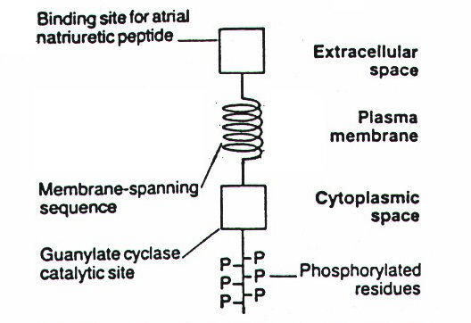
cGMP Metabolism and Action

Slide 23
Calcium-Dependent Protein Kinases
Protein Kinase C
  Requires calcium, diacylglycerol, and phospholipid for activity
  Diacylglycerol is generated by the action of phospholipase C, C refers to calcium
  DAG and phospholipid were also described as necessary for the activation of this enzyme
  It is paradoxical to have PKCs that are independent of Ca²⁺ and DAG
Calcium-Calmodulin-Dependent Protein Kinases
  CAM Kinases I, II, III, IV
  Several other protein kinases activated by calmodulin including myosin-light chain kinase, phosphorylase kinase, some isoforms of adenylyl cyclase and some isoforms of phosphodiesterase

Slide 24
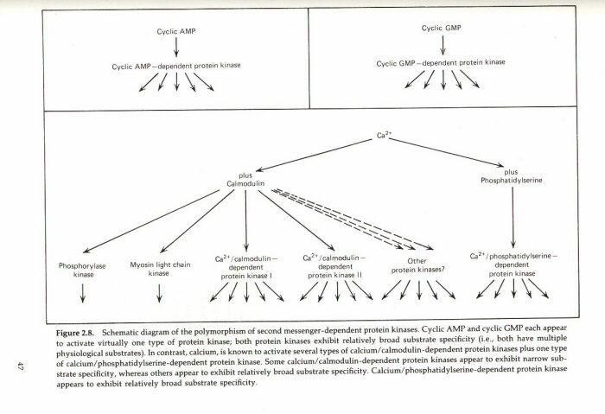
Calcium-Dependent PKs

Slide 25
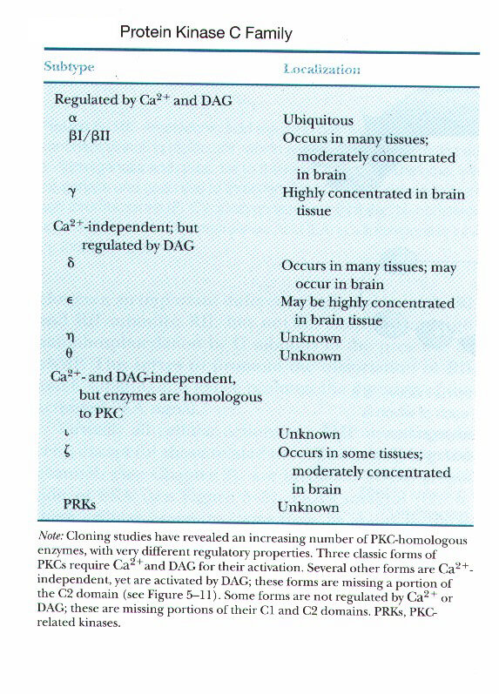
Protein Kinase C Family
PKC
  C refers to calcium
  DAG and phospholipid were also described as necessary for the activation of this enzyme
  There are many isozymes that are products of different genes

Slide 26
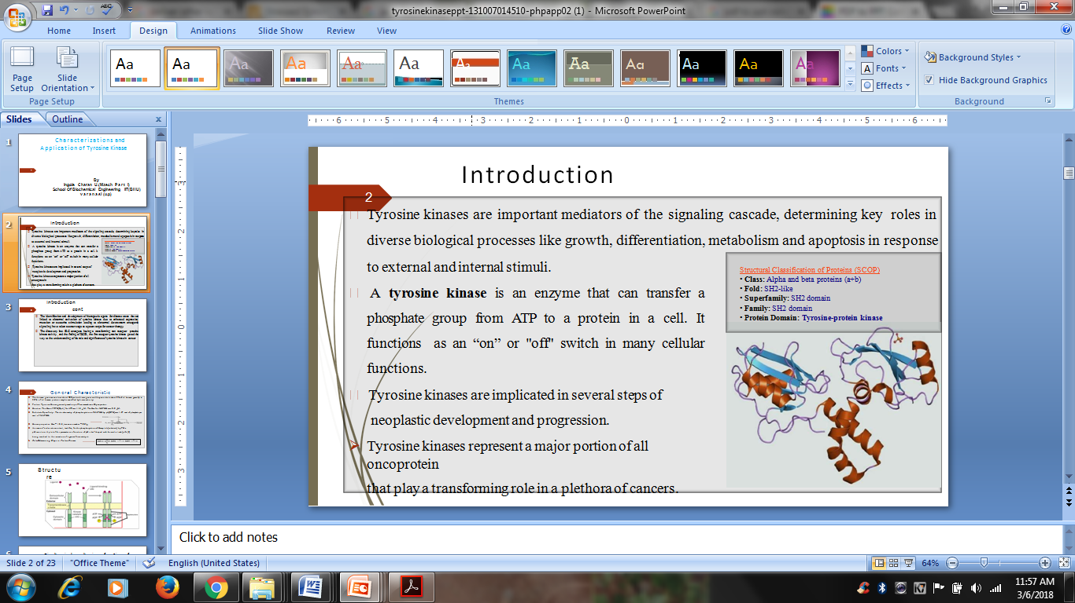
Tyrosine Kinases

Slide 27
Tyrosine kinase mechanism
Tyrosine kinase receptors are a family of receptors with a similar structure.
They each have a tyrosine kinase domain (which phosphorylates proteins on tyrosine residues), a hormone binding domain, and a carboxyl terminal segment with multiple tyrosines for autophosphorylation.
When hormone binds to the extracellular domain the receptors aggregate.

Slide 28
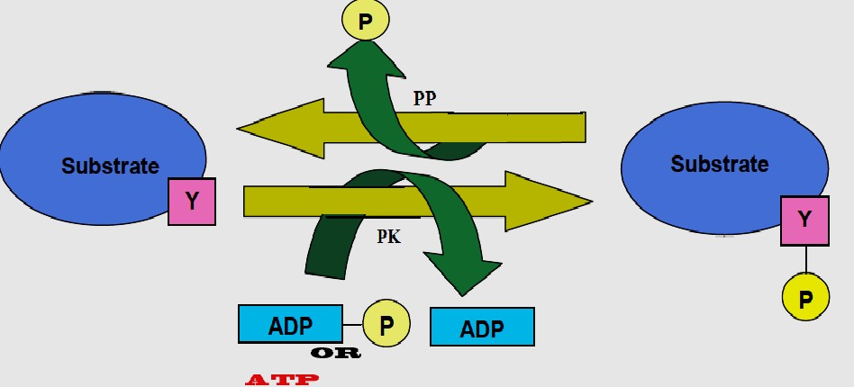
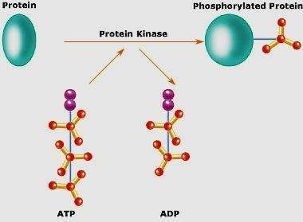
Biochemical mechanism of action of tyrosine kinase

Slide 29
Classification of RTK
Receptor tyrosine kinases (RTKs)-The RTK family includes the receptors for insulin and for many growth factors such as
Epidermal growth factor (EGF)
Fibroblast growth factor(FGF)
Platelet-derived growth factor (PDGF)
Vascular endothelial growth factor(VEGF)
Nerve growth factor (NGF)
Nonreceptor tyrosine kinases (NRTKs)
Src – Proto oncogene
Janus kinases (Jaks)
Abl – Abelson murine leukemia

Slide 30
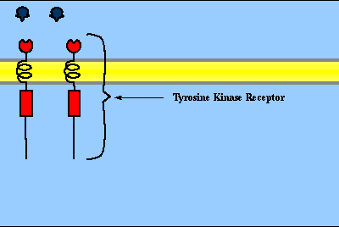

Slide 31
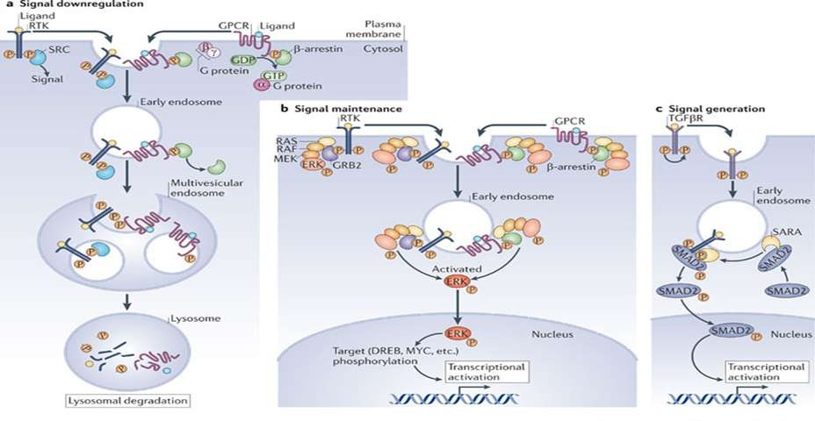
Application
The Role of Tyrosine Kinase Activity in Endocytosis, Compartmentation, and down regulation of the Epidermal Growth Factor Receptor

Slide 32
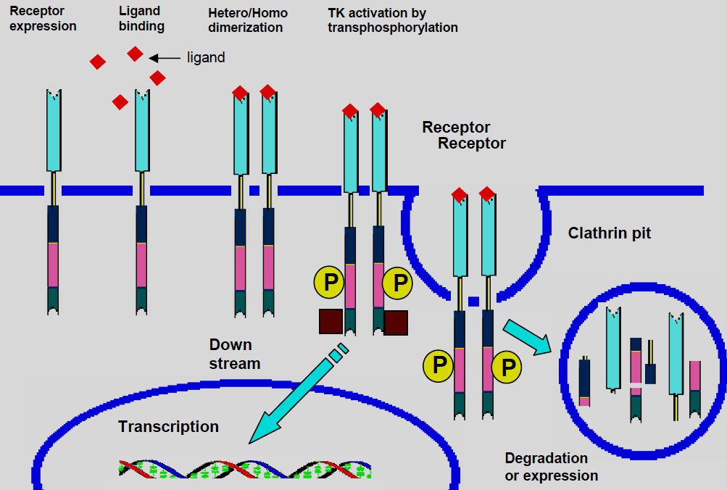

Slide 33
Ribosomal s6 kinase
Ribosomal s6 kinase (rsk) is a family of protein kinases involved in signal transduction.
There are two subfamilies of rsk, p90^{rsk}, also known as MAPK-activated protein kinase-1 (MAPKAP-K1), and p70^{rsk}, also known as S6-H1 Kinase or simply S6 Kinase.
There are three variants of p90^{rsk} in humans, rsk 1-3.
Rsks are serine/threonine kinases and are activated by the MAPK/ERK pathway.
There are two known mammalian homologues of S6 Kinase: S6K1 and S6K2.

Slide 34
Cross talk b/w signaling pathways
Crosstalk refers to instances in which one or more components of one signal transduction pathway affects another.
Most common form being crosstalk between proteins of signaling cascades.
In these signal transduction pathways, there are often shared components that can interact with either pathway.
A more complex instance of crosstalk can be observed with transmembrane crosstalk between the extracellular matrix (ECM) and the cytoskeleton.

Slide 35
cAMP pathway
One example of crosstalk between proteins in a signalling pathway can be seen with cyclic adenosine monophosphate's (cAMP) role in regulating cell proliferation by interacting with the mitogen-activated protein (MAP) kinase pathway.
cAMP is a compound synthesized in cells by adenylate cyclase in response to a variety of extracellular signals..
cAMP primarily acts as an intracellular second messenger whose major intracellular receptor is the cAMP-dependent protein kinase (PKA) that acts through the phosphorylation of target proteins.
The signal transduction pathway begins with ligand-receptor interactions extracellularly.
This signal is then transduced through the membrane, stimulating adenylyl cyclase on the inner membrane surface to catalyze the conversion of ATP to cAMP.

Slide 36
ERK, (Extra cellular signal regulated kinases) a participating protein in the MAPK signaling pathway, can be activated or inhibited by cAMP.
cAMP can inhibit ERKs in a variety of ways, most of which involve the cAMP-dependent protein kinase (PKA) and the inhibition of Ras-dependent signals to Raf-1.
cAMP can also stimulate cell proliferation by stimulating ERKs.
This occurs through the induction of specific genes via phosphorylation of the transcription factor CREB by PKA.
Though ERKs do not appear to be a requirement for this phosphorylation of CREB, the MAPK pathway.

Slide 37
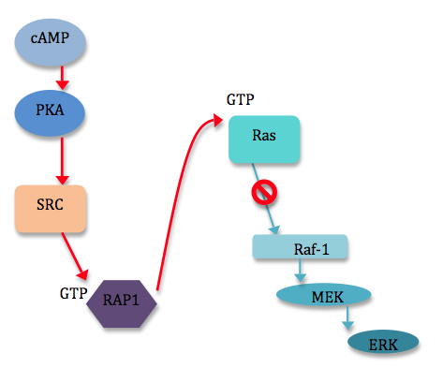

Slide 38
ECM
Crosstalk can even be observed across membranes.
Membrane interactions with the extracellular matrix (ECM) and with neighboring cells can trigger a variety of responses within the cell.
However, the topography and mechanical properties of the ECM also come to play an important role in powerful, complex crosstalk with the cells growing on or inside the matrix.

Slide 39
For example, integrin-mediated cytoskeleton assembly and even cell motility are affected by the physical state of the ECM.
Binding of the α5β1 integrin to its ligand (fibronectin) activates the formation of fibrillar adhesions and actin filaments.
In turn, binding of the same integrin (α5β1) to an immobilized fibronectin ligand is seen to form highly phosphorylated focal contacts/focal adhesion (cells involved in matrix adhesion) within the membrane and reduces cell migration rates and matrix immobilization.
Matrix immobilization inhibits the formation of fibrillar adhesions and matrix reorganization.
Likewise, players of other signaling pathways inside the cell can affect the structure of the cytoskeleton and thereby the cell’s interaction with the ECM.

Slide 40
